Slide 1
Text Similarity Measures
Elza cherian

Slide 2
Similarity
Distance between two vectors where the vector dimensions represent the features of two objects.
Measure of how different or alike two data objects are. If the distance is small, the objects are said to have a high degree of similarity and vice versa. Score in the range of [0, 1] is called the similarity score.
Highly dependent on the domain and use case. For example, two cars can be similar because of simple things like the manufacturing company, color, price range, or technical details like fuel type, wheelbase, horsepower.
So, special care should be taken when calculating similarity across features that are unrelated to each other or not relevant to the problem.
The use of similarity measures is quite prominent in the field of natural language processing. Everything from information retrieval systems, search engines, paraphrase detection to text classification, automated document linking, spell correction makes use of similarity measures.

Slide 3
Similarity Measures
Jaccard Index
Euclidean Distance
Levenshtein distance
Cosine Similarity

Slide 4
Jaccard Index
Jaccard similarity coefficient, treats the data objects like sets. It is defined as the size of the intersection of two sets divided by the size of the union.
Sentence 1: The bottle is empty.
Sentence 2: There is nothing in the bottle.
To calculate the similarity using Jaccard similarity, first perform text normalization to reduce words their roots/lemmas. There are no words to reduce in this case.

Slide 5
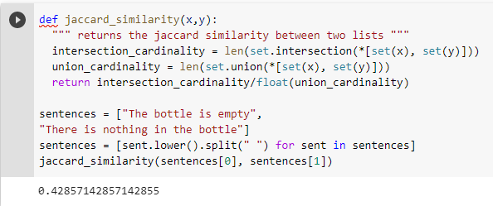
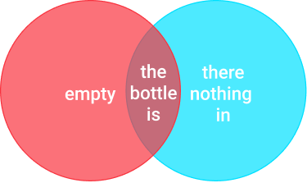
Size of the intersection of the two sets: 3
Size of the union of the two sets: 1+3+3 = 7
Using the Jaccard index, we get a similarity score of 3/7 = 0.42

Slide 6
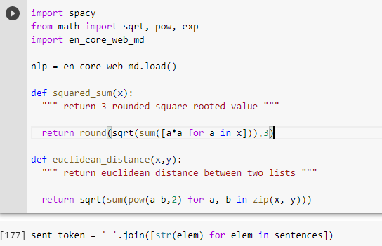
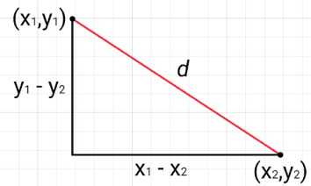
Euclidean Distance
Euclidean distance, or L2 norm, is the most commonly used form of the Minkowski distance. Uses the Pythagoras theorem to calculate the distance between two points as indicated in the figure below:
The larger the distance d between two vectors, the lower the similarity score and vice versa.

Slide 7


The distances can vary from 0 to infinity, need to use some way to normalize them to the range of 0 to 1.
Although, typical normalization formula that uses mean and standard deviation, it is sensitive to outliers.
That means if there are a few extremely large distances, every other distance will become smaller as a consequence of the normalization operation.
So the best option here is to use something like the Euler’s constant as follows:

Slide 8
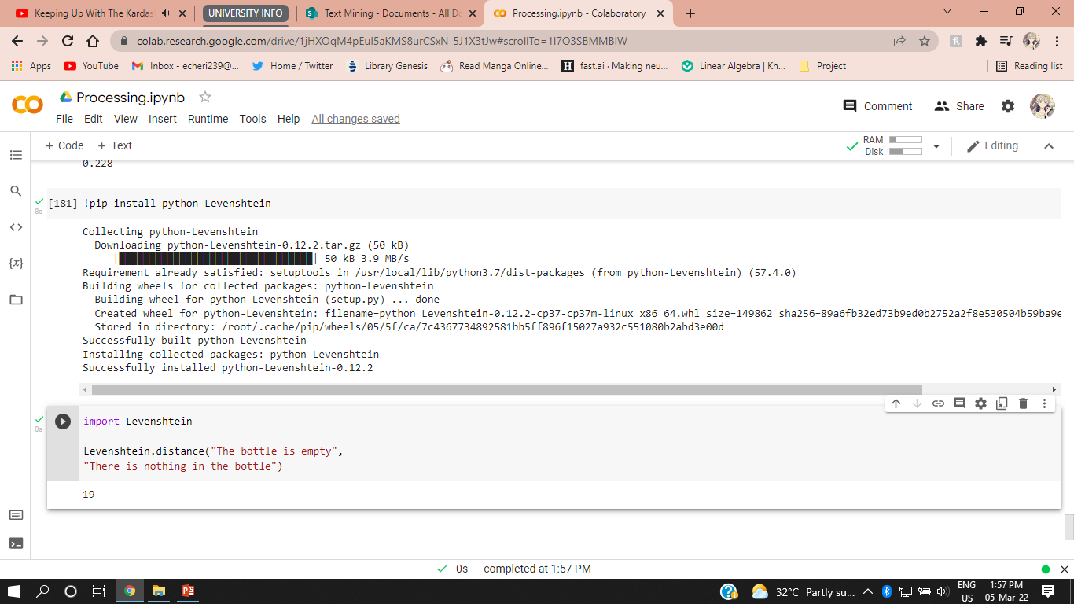
Levenshtein Distance
Levenshtein distance is a string metric for measuring the difference between two sequences. It is the minimum number of single-character edits (insertions, deletions or substitutions) required to change one word into the other.
Calculate how many transformations need to perform on the string A to make it equal to string B. Algorithm is also known as Edit Distance.

Slide 9
Sometimes both sentences convey pretty much the same information, but 20 transformations are needed to get from one to another.
So if set the strings to be auto-matched below some threshold, 20 probably won’t be that threshold, because it’s just too large for simple and short sentences like these two.
Cosine similarity overcomes this issue

Slide 10
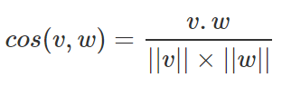
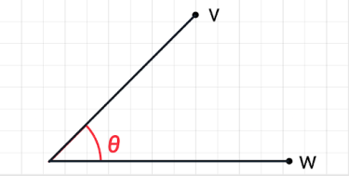
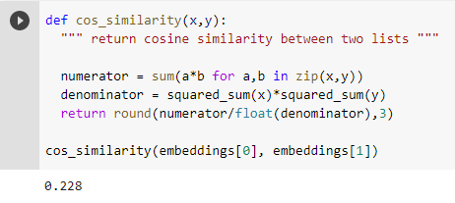
Cosine Similarity
Similarity of two vectors as the cosine of the angle between two vectors.
It determines whether two vectors are pointing in roughly the same direction. So if the angle between the vectors is 0 degrees, then the cosine similarity is 1.
It is given as:
Where ||v|| represents the length of the vector v, 𝜃 denotes the angle between v and w, and ‘.’ denotes the dot product operator.

Slide 11
Similarity Measure | Likely used in | Rarely used in
Jaccard similarity | Assessing the similarity of documents when repetition is not an issue. For instance, if a term like “HD” or “thermal efficiency” is used multiple times in one description and just once in another, if the total number of unique words stays the same, the Jaccard similarity will remain unchanged. | Does not work with text embeddings. Limited to assessing the lexical similarity of text, i.e., how similar documents are on a word level.
Euclidean | text classification | Similarity metrics drop if an additional ‘empty’ is added to first example sentence. Doesn’t work well with the sparse vectors of text embeddings.
cosine similarity | Not affected by the magnitude/length of the feature vectors. Creating a topic tagging algorithm. If a word (e.g. senate) occurs more frequently in document 1 than it does in document 2, assume that document 1 is more related to the topic of Politics. However, it could also be the case that we are working with news articles of different lengths. Then, the word ‘senate’ probably occurred more in document 1 simply because it was way longer. Less sensitive to a difference in lengths. So cosine similarity is generally preferred over Euclidean distance when working with text data. The only length-sensitive text similarity use case that comes to mind is plagiarism detection. | similarity metrics drop if an additional ‘empty’ is added to our first example sentence

Slide 12
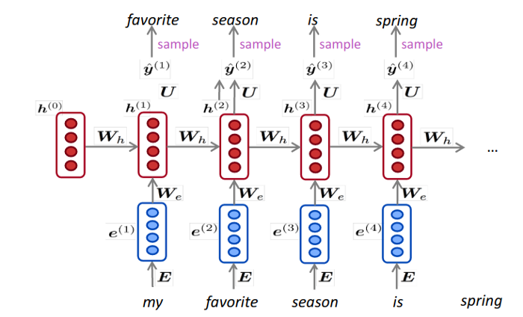
Contextual Word Embeddings (ELMo)
Proving more than one representation for each word based on the context in which it appears is the core idea behind contextual word embeddings.
This idea is implemented using an RNN language model trained similarly to Word2Vec in an unsupervised manner more specifically we use RNNs to predict, given a current word in a sentence, the next word.
Use these networks for their ability to capture and maintain long term dependencies in their hidden states.
The idea is that after feeding the current word we can concatenate the hidden state to the usual Word2Vec representation to maintain both information on the current word and the past context.
One of the first systems to implement this idea was TagLM by Peters and co.

Slide 13
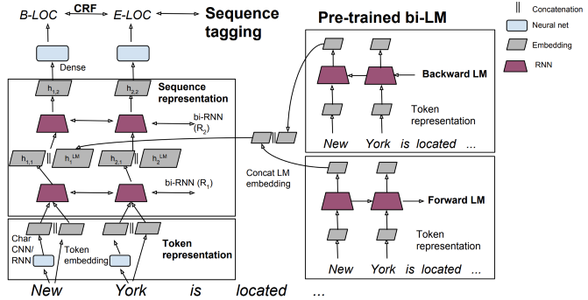
TagLM
Used a pre-trained Bi-LSTM language model to produce the “contextual part” of the word embedding that gets concatenated to a Word2Vec vector or more complex character level CNN/RNN generated representation of the word.
New embedding effectively replacing Word2Vec or GloVe vectors.
Work very similarly, the main difference is that ELMo uses a two layer Bi-LSTM for the pre-trained language model and the embedding to concatenate is a learnable, during fine-tuning, combination of the two layers to be optimize for the specific task.
ELMo also ditches Word2Vec completely by relying only on character level CNN/RNNs for the first part of the word representation.

Slide 14
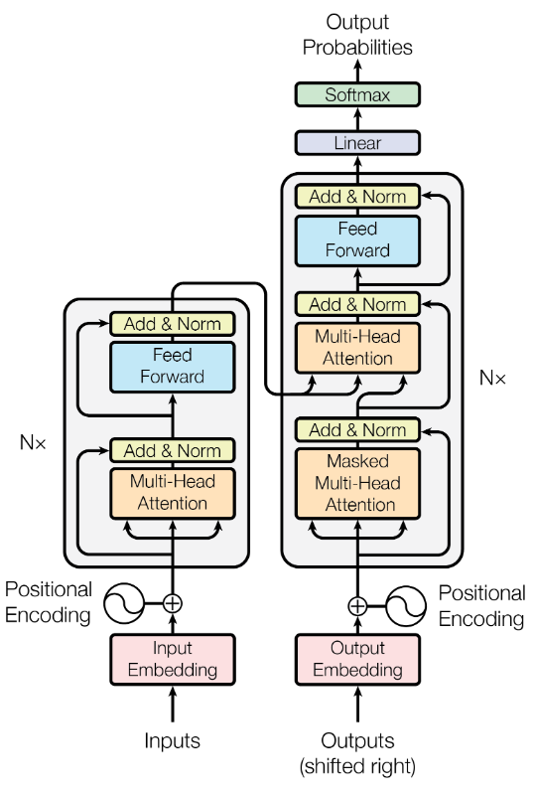
Transformers (BERT, GPT)
The main feature of the Transformer is that it uses attention, the concept that helps with alignment in seq2seq architectures for translation, to capture relationships between the words of a sentence similarly to how convolution do it.
Designed to work on sequence data and will take an input sequence and use it to generate an output sequence one element at a time.
Two main segments, the first is an encoder that operates primarily on the input sequence and the second is a decoder that operates on the target output sequence during training and predicts the next item in the sequence.
The parts of a transformer that are particularly important are the embeddings, the positional encoding block, and the multi-head attention blocks.

Slide 15
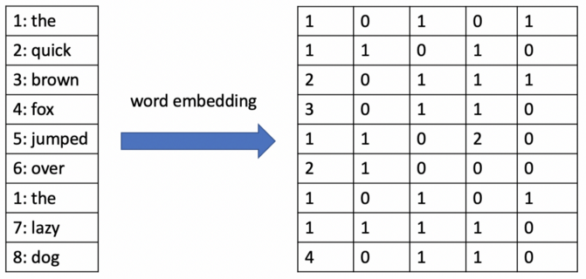
Input and Output Embedding
Embedding layer takes a sequence of words and learns a vector representation for each word.
The Word2Vec algorithm uses a large sample of text as training data and learns word embeddings using one of two algorithms:
Continuous bag of words (CBOW) — in this case, the algorithm tries to predict a center word in the middle of the sentence using the surrounding context words.
Skip-gram model — in this case, the algorithm does the opposite of CBOW and predicts the distribution of context words from a center word.
Shallow neural network with just one hidden layer to make these predictions.
The word vectors come from the weights learned in the hidden layer and are used to represent the semantic meaning of each word in relation to other words.

Slide 16
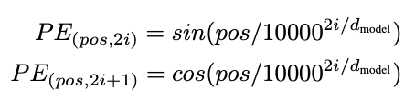
Positional Encoding
Applies a function to the embedding matrix that allows a neural network to understand the relative position of each word vector even if the matrix was shuffled.
Inject information about the position of each word vector by concatenating sine and cosine functions of different wavelengths/frequencies to these vectors.
Consider an input with 10,000 possible positions, the positional encoding block will add sine and cosine values with wavelengths that increase geometrically from 2𝝅 to 10000*2𝝅.
Mathematically represent the relative position of word vectors such that a neural network can learn to recognize differences in position.

Slide 17
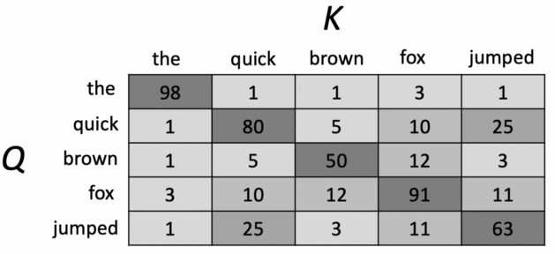
Multi-Head Attention
Each attention block takes three input matrices:
A query matrix, Q, of dimension n.
A key matrix, K, of dimension n.
And a value matrix, V, m.
Let’s say the query matrix has values that represent a sentence in English such as “the quick brown fox jumped”.
Transformer will have learned weights for individual English words in a key matrix and the query matrix will represent the actual input sentence.
Computing the dot product of the query and key matrix is known as self-attention and will produce an output that looks something like this.

Slide 18
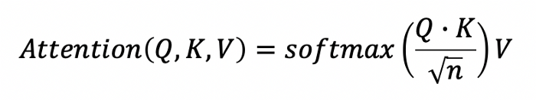
Attention Formula
These scores are later scaled by dividing the dot product matrix by the square root of the number of dimensions in the key and query matrices.
A softmax activation function is applied to the scaled scores to convert them into probabilities.
These probabilities are referred to as the attention weights, which are then multiplied by the value matrix to produce the final output of the attention block.

Slide 19

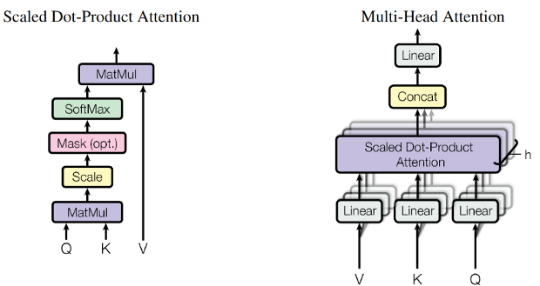
Multi-head Attention
In order to capture more distant dependencies similarly to convolutions we can stack multiple transformers blocks.

Slide 20
Why attention?
key and value matrices are learned parameters while the query matrix is defined by the input word vectors.
It is also important to note that the words of a sentence are passed into the transformer at the same time and the concept of a sequential order present in LSTMs is not that apparent with transformers.
This is why the positional encoding blocks mentioned earlier are important. They allow attention block to understand the relative position of words in sentences.
A single attention block can tell a model to pay attention to something specific such as the tense in a sentence.
Adding multiple attention blocks allows the model to pay attention to different linguistic elements such as part of speech, tense, nouns, verbs, and so on.

Slide 21
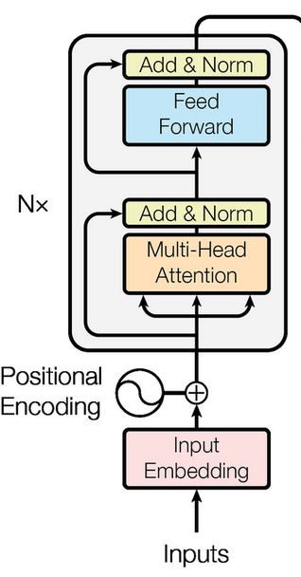
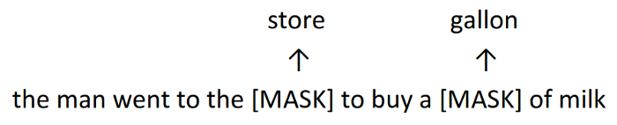
Masking in BERT
Decoder block works somewhat differently.
BERT uses the transformer block to train a language model using a masking technique where the system isn’t tasked with guessing the next word but rather one of the words masked out in the sentence.
This way it is able to use the entire context for prediction and not only the left context.

Slide 22
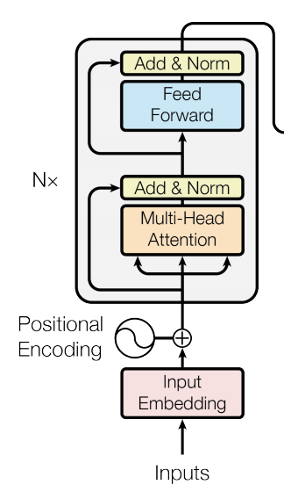
Feed-Forward Layer
It is simply a single fully-connected layer of a feed-forward neural network. The feed-forward layer operates on the output attention vectors and learns to recognize patterns within them.
The encoder is the part of the transformer that chooses what parts of the input to focus on.
The encoder can take a sentence such as “the quick brown fox jumped”, computes the embedding matrix, and then converts it into a series of attention vectors.
The multi-head attention block initially produces these attention vectors, which are then added and normalized, passed into a fully-connected layer (Feed Forward in the diagram above), and normalized again before being passed over to the decoder.

Slide 23
During training, the decoder operates directly on the target output sequence.
In the decoder, separate embedding vectors are computed for each French word in the sentence, and the positional encoding is also applied in the form of sine and cosine functions.
However, a masked attention block is used, meaning that only the previous word in the French sentence is used and the other words are masked.
This allows the transformer to learn to predict the next French word.
The outputs of this masked attention block are added and normalized before being passed to another attention block that also receives the attention vectors produced by the encoder.

Slide 24
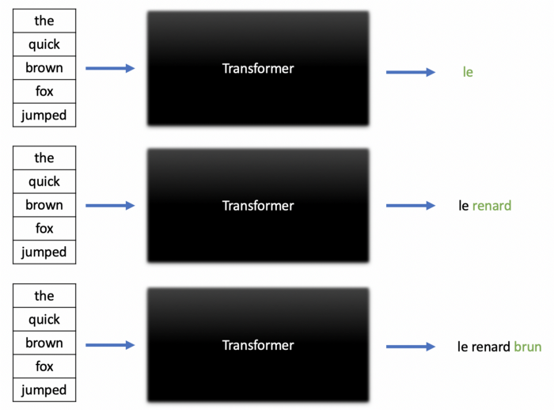
Overall Working
A feed-forward network receives the final attention vectors and uses them to produce a single vector with a dimension equal to the number of unique words in the model’s vocabulary.
Applying the softmax activation function to this vector produces a set of probabilities corresponding to each word.
In this example, these probabilities predict the likelihood of each French word appearing next in the translation.

